Slide 1


Data Governance: Protecting Student Privacy
Information Technology Services| HUTCHINSON COMMUNITY COLLEGE
Notes:
Good afternoon. My name is Mandie Lyons. I am the Chief Information Officer at Hutchinson Community College. My background is in software development, leading software development teams, managing software projects, developing and implementing intelligent automations and managing digital transformation efforts in logistics, finance, manufacturing and agriculture.
I have been in higher ed for almost 16 months now, and what a wild ride it has been. In my time at HutchCC we have digitized student ids, installed keyless entry to our dorms, migrated away from GroupWise to Microsoft Outlook, implemented Exagrid for immutable backups, created a true redundant offsite backup of our legacy SIS (POISE/PX), developed an integration between Regent Financial Aid and POISE/PX, developed an integration between Slate CRM and POISE/PX, and worked through two large software selection projects for a payroll system and modern SIS office backup. What do all those projects have in common? Data. More importantly, student data.
To say that data governance has been on my mind would be an understatement.
In a world where approximately 328.77 million terabytes of data are created each day, data governance is more important than ever before. How can we, in higher education, be good stewards and protect data privacy, confidentiality and security while democratizing contextual data across the institution?

Slide 2

My Info
Mandie Ann Lyons
Chief Information Officer
Hutchinson Community College
Email: lyonsm@hutchcc.edu
LinkedIn: linkedin.com/in/mandie-lyons-hutchcc
Github: github.com/mandieannlyons
Repo: github.com/mandieannlyons/Data-Governance

Slide 3
Five Components of Data Governance
Performing due diligence
Building a data inventory
Building controls
Forming a data governance panel
Providing accurate and clear notice regarding data governance policies
Information Technology Services| HUTCHINSON COMMUNITY COLLEGE
Notes:
What is data governance?
An organizational approach to data and information management that is formalized as a set of policies and procedures that encompass the full life cycle of data, from acquisition to use to disposal.
Data governance is everything we do to ensure data is secure, private, available and usable – this includes the actions people take, the processes people follow, and the technology that supports them.
Five components of data governance:
Perform due diligence – check who has access to what data and where the data is going.
Build a data inventory – also known as the record of authority, a data inventory identifies the personal data your organization collects, as well as where you keep it, how you protect it, and who has access to it. Key to data inventory is pinpointing the most sensitive data so you can establish controls that ensure its integrity and security.
Build controls – design policies and procedures that define how people and systems use data internally and externally. Only allow access to the data that people need to do their jobs. Create a system for testing and auditing controls, and make changes as needed.
Form a data governance panel – include legal, IT, and other various stakeholders that can help make decisions regarding – how data is accessed, how access is controlled, and how data will support and impact business.
Provide accurate and clear notice regarding data governance policies – once policies are designed, make sure to give clear notice to all stakeholders. Depending on the needs of your institution, your governance structure may change so communicate changes with the right people, outlining how it will impact their jobs. You may have to invest time and resources training employees regarding how to implement your governance policies. This creates alignment and keeps everyone accountable – an important part of the data governance system.
Many of us have built a data governance strategy and worked through these components even though we may have used differing terminology. And some of us may be in the thick of building this now.
***Ask for input from the audience.

Slide 4
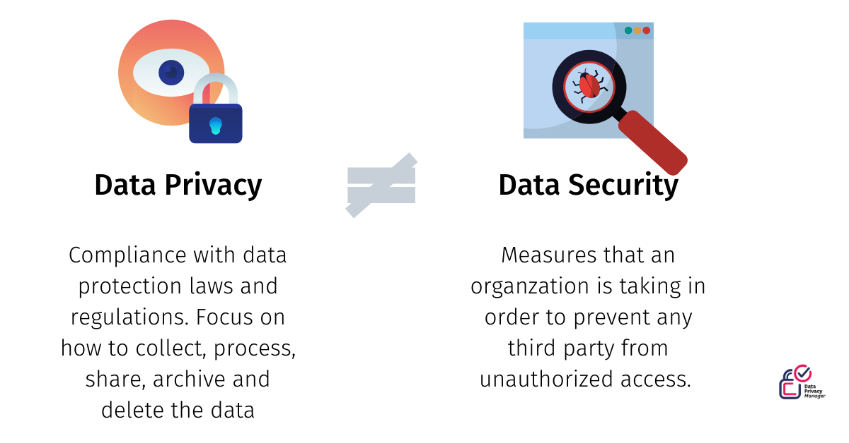
Data Privacy v. Data Security
Information Technology Services| HUTCHINSON COMMUNITY COLLEGE
Notes:
Data Privacy is the right to control who gets to see your personal information.
Data Security protects information from unauthorized access, use, and disclosure.
A popularly held belief is that people who have grown up using digital technologies ("digital natives," born in 1983 and later) have little concern for the privacy of their data. This is particularly concerning because many in this age group live much of their academic and personal lives online.
A 2016 EDUCAUSE Center for Analysis and Research (ECAR) survey found that one-third of undergraduate students were "concerned that technology advances may increasingly invade [their] privacy." A Gallup poll in 2015 found that 44 percent of Millennials believe their personal information is kept private "some of the time" and that 26 percent believe their personal information is kept private "little" or "none of the time." In 2016, the Gallup poll showed that 44 percent of Millennials trusted companies to keep their personal information private "all" or "most of the time" but that 33 percent trusted companies to keep their personal information private "little" or "none of the time," a 7 percentage point increase from 2015. These surveys reflect students' growing awareness and distrust of entities possessing their data.
https://er.educause.edu/articles/2021/2/data-privacy-in-higher-education-yes-students-care
In an article published on March 24th of this year, Info-Tech Research Group says that today’s students are wary of privacy risks and value privacy and data protection. As a result, our institutions are now under increased pressure to protect personal data for students in the new digital era, especially sensitive data.
https://www.prnewswire.com/news-releases/higher-education-institutes-must-address-students-growing-data-privacy-concerns-says-info-tech-research-group-301781218.html
"With a veritable explosion of data breaches highlighted almost daily across the globe, and the introduction of heavy-handed privacy laws and regulatory frameworks, privacy has taken center stage," says Alan Tang, principal re
search director at Info-Tech Research Group. "Students care about their data privacy, and this concern is increasing.“
***Ask for input from the audience. Does your institution have an up-to-date privacy policy? How does your institution let students know that data privacy and data security are taken seriously?

Slide 5
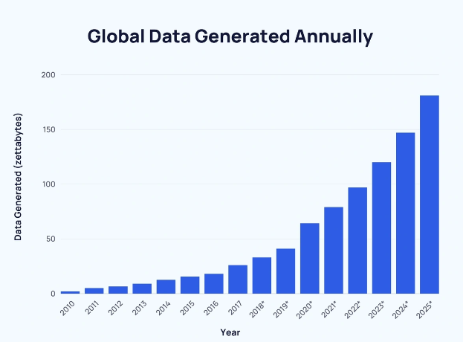
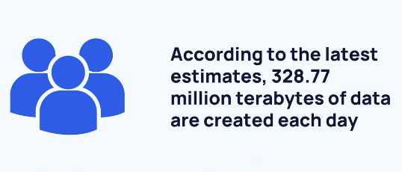
Data Stewardship
Information Technology Services| HUTCHINSON COMMUNITY COLLEGE
Notes:
FACTS: https://explodingtopics.com/blog/data-generated-per-day
- Approximately 328.77 million terabytes of data are created each day
- The amount of data generated annually has grown year-over-year since 2010.
- In fact, it is estimated that 90% of the world's data was generated in the last two years alone.
- The US has over 10x more data centers (5,388) than any other country.
How can we, as technology leaders, be good data stewards of this vast amount of data? What even is a data steward?
Data stewards are the people within your institution that are responsible for implementing data governance policies and standards and maintaining data quality and security. Data stewards are managers, administrators…and us.
Data stewardship can be defined as a comprehensive approach to data management to ensure quality, integrity.
***Ask for input from the audience. Does your institution have designated data stewards? Do you talk about data stewardship as a part of overall data governance?

Slide 6
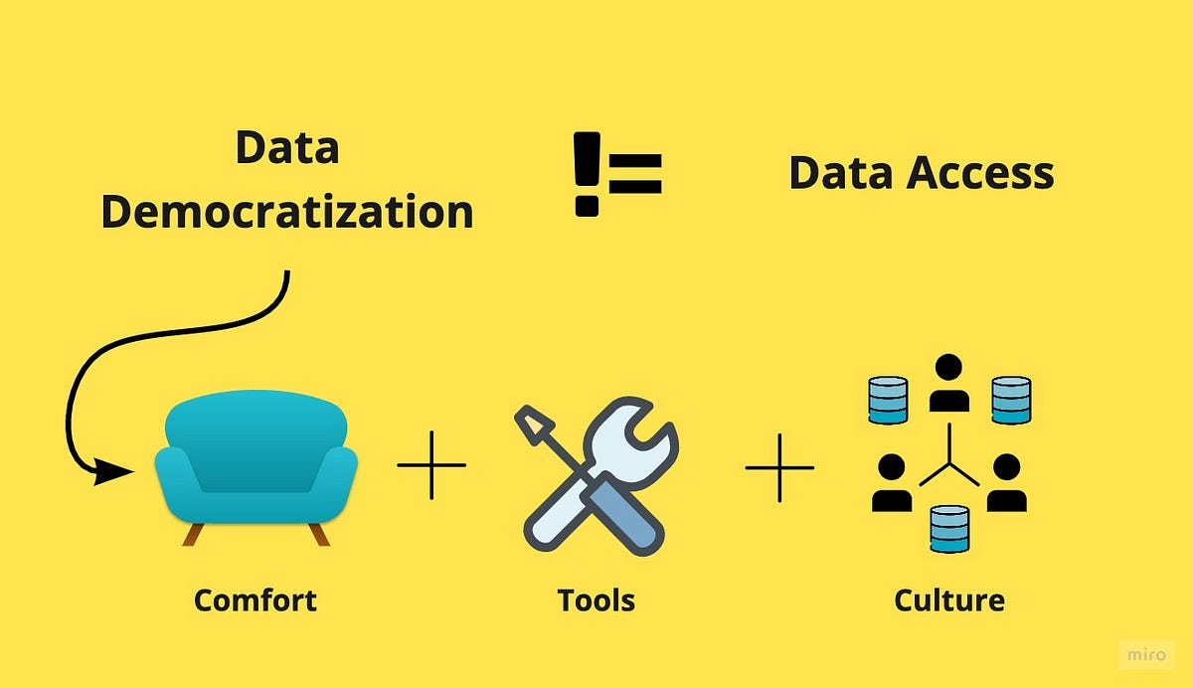
Democratizing Data
Information Technology Services| HUTCHINSON COMMUNITY COLLEGE
Notes:
Data democratization is more than access to data – it is the ongoing process of enabling everybody in an organization, irrespective of their technical know-how, to work with data comfortably, to feel confident talking about it, and, as a result, make data-informed decisions and build student experiences powered by data.
An institution that truly wants to democratize data needs to embrace the following principles – the trifecta of data democratization:
Empower employees to feel comfortable asking data-related questions.
Provide the right tools to enable everybody to work with data.
Perceive democratization as an ongoing process that might require a cultural shift at our institutions.
The Trifecta of Data Democratization solves these problems:
I don’t have access to the data I need (we can’t leave this up to the SQL guy because he doesn’t want to give people access to anything)
I can’t trust the data
I have access to data, but I lack the skills to find answers to questions
***Ask for input from the audience. Are you democratizing data at your institution? Outside of IR? Any lessons learned?

Slide 7
Questions???
Information Technology Services| HUTCHINSON COMMUNITY COLLEGE

